Slide 1
Waipu Cove Dune Restoration
Laura Shaft
NRC CoastCare Co-ordinator
Angus McCulloch
Waipu Cove Reserve Board
Rick Stolwerk
Waipu Cove Surf Lifesaving Club
Notes:
Need Waipu Cove Reserve Board/Camp Waipu Cove and Waipu Cove Surf Club logos

Slide 2
Waipu Cove Dune Restoration
Aim to restore dune whilst maintaining and enhancing recreation reserve
Notes:
The Waipu Cove dune restoration project is a collaborative venture between Waipu Cove Reserve Board, Waipu Cove Surf Life Saving Club and Northland Regional Council CoastCare. The aim of the project has been to restore natural defences against coastal hazards whilst maintaining and enhancing the recreation opportunities of the beach and reserve.

Slide 3
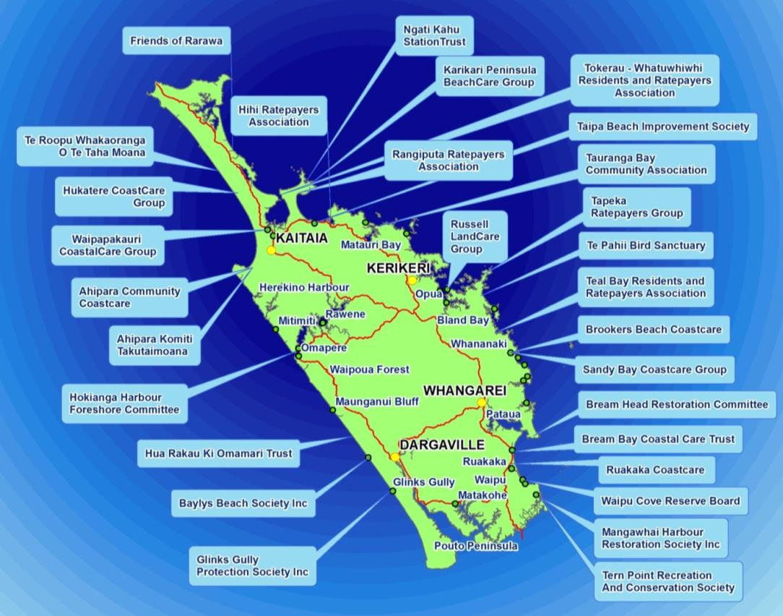
Northland CoastCare groups
Notes:
Currently 29 CoastCare groups
The Northland Regional Council CoastCare programme was set up in 2005 to help protect and restore Northland’s coastal sand dunes by supporting community based CoastCare groups to undertake dune restoration. Range of group types from Residents and Ratepayers Associations to informal groups of local residents
One thing in common – all working to protect their local sand dunes

Slide 4
Waipu Cove Reserve Board
Notes:
This project is based at Waipu Cove, hand over to Angus McCulloch, a current trustee to provide more information on the Waipu Cove Reserve Board

Slide 5
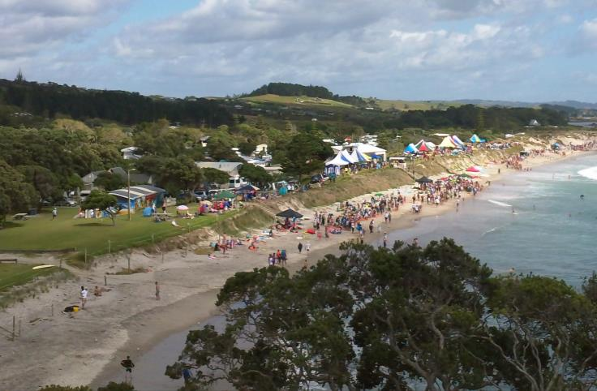
Waipu Cove Reserve Board
The Waipu Cove Reserve Board is a non-profit voluntary body
All revenue from the camp ground and other activities is put back into the camp and public reserve.

Slide 6
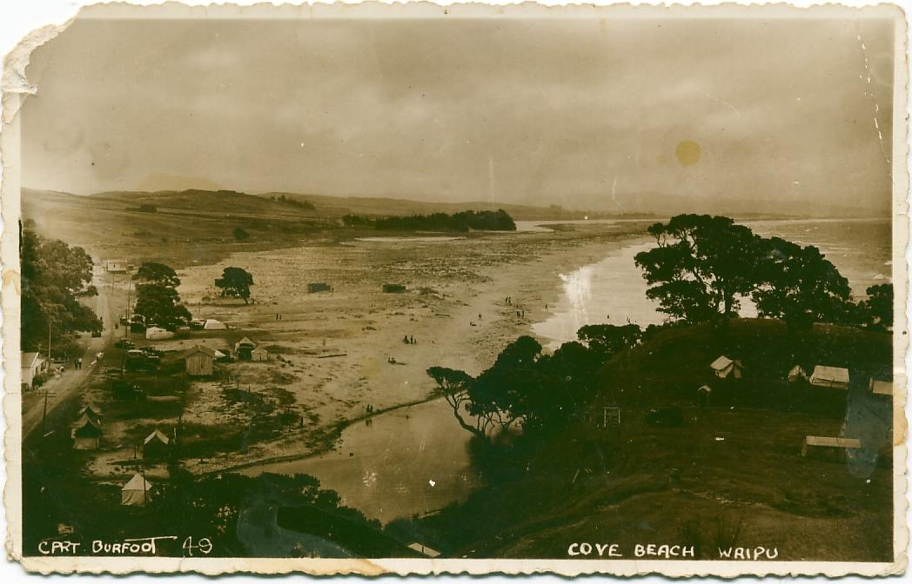
History of Waipu Cove
Notes:
Info from Rick/Angus

Slide 7
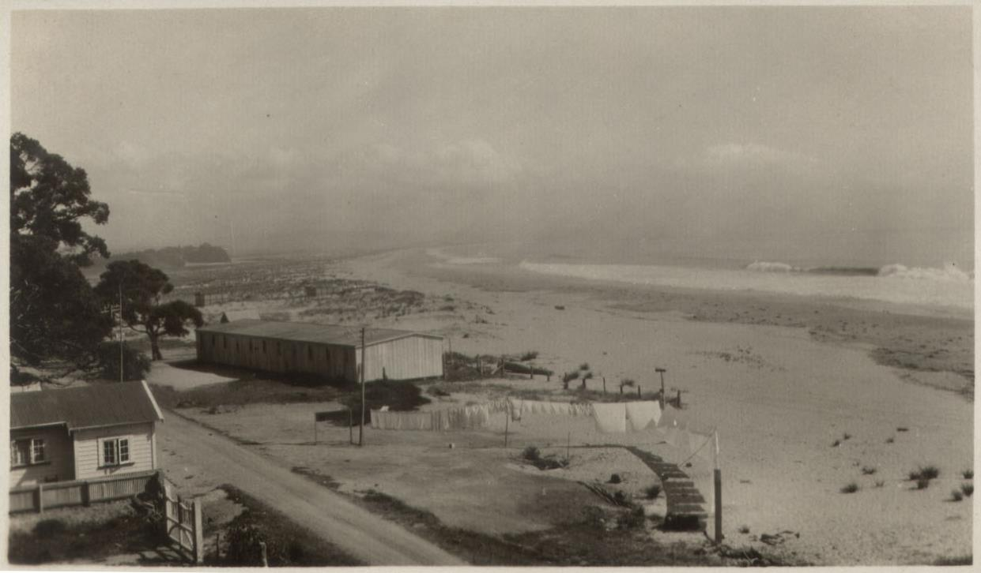
History of Waipu Cove
Notes:
Info from Rick/Angus

Slide 8
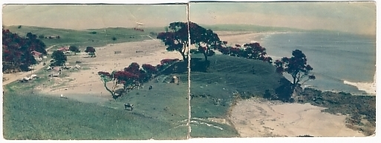
History of Waipu Cove
Notes:
Info from Rick/Angus

Slide 9
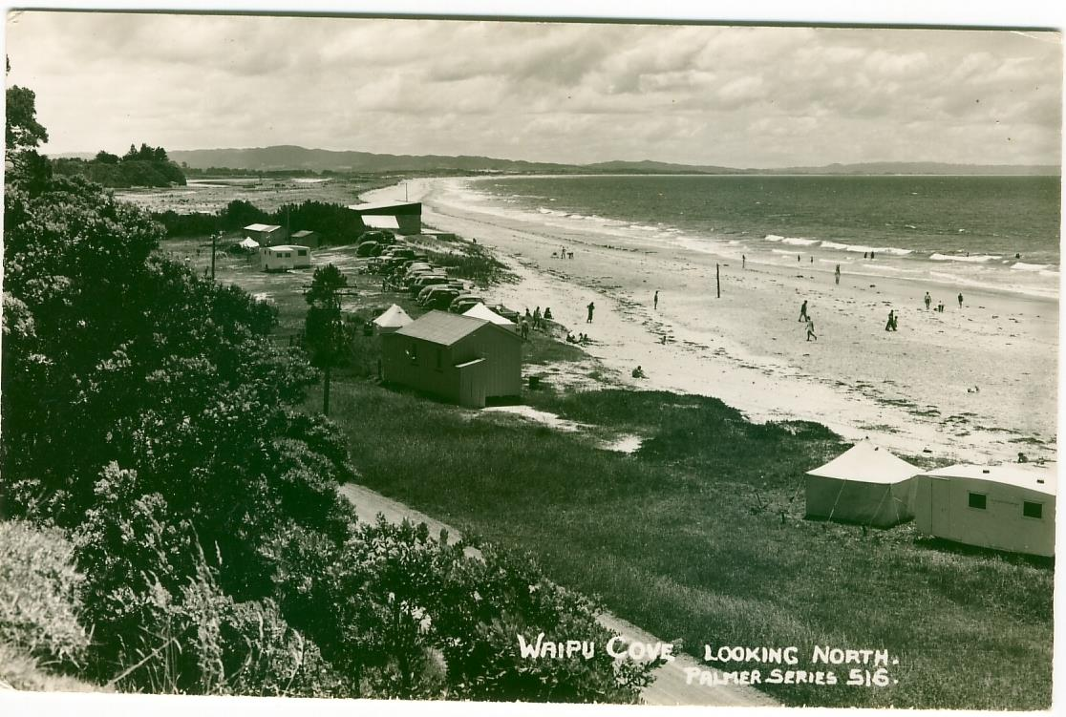
History of Waipu Cove
Notes:
Info from Rick/Angus

Slide 10
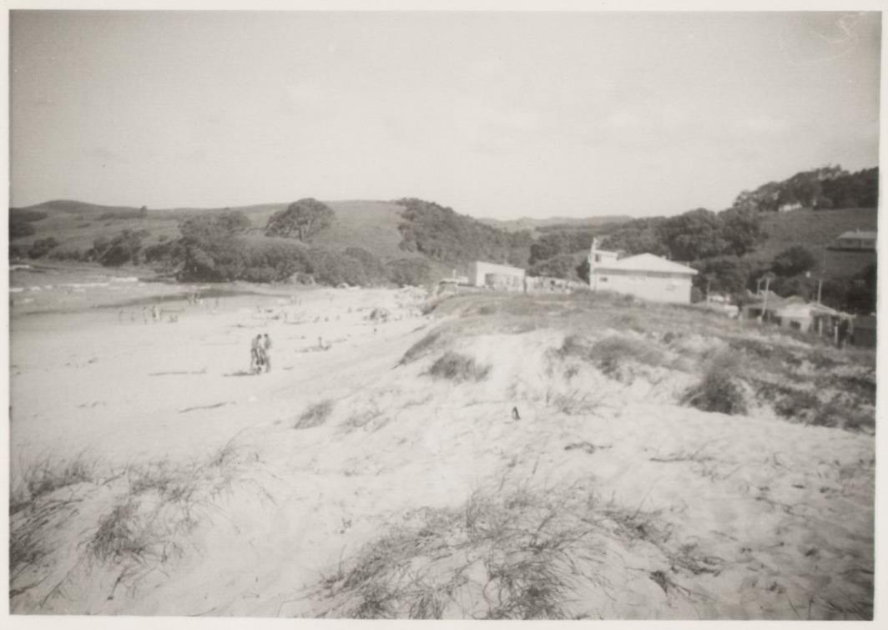
History of Waipu Cove
Notes:
1969

Slide 11
Notes:
Waipu Cove in the 1950’s

Slide 12
Notes:
Same view – taken in 2012

Slide 13
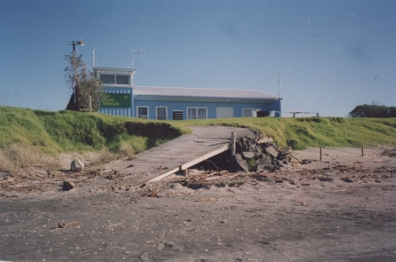
History of Waipu Cove
Waipu Surf Lifesaving Club, Photo taken between 1992-1995
Notes:
Waipu Surf Club (photo taken between 1992-1995). Ramp washed away 1999 (during domain board meeting)

Slide 14
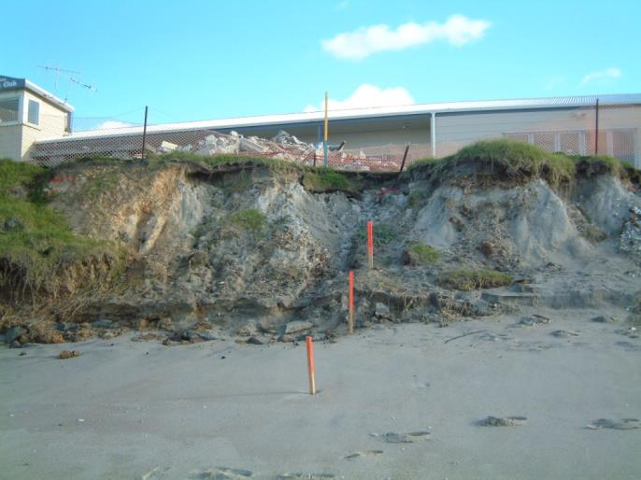
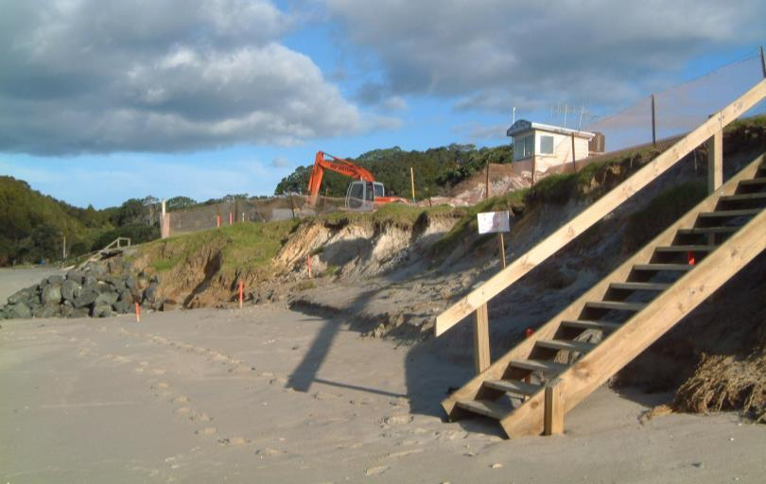
Previous attempts at erosion control
Waipu Surf Lifesaving Club, July 2002
Notes:
Waipu Surf Club July 2002
Plan to place fill in front of surf club to prevent erosion – did not go ahead. Built up on top to reduce run-off erosion. Plan for gabion baskets, did not happen.
Photos show fill

Slide 15
Early dune restoration efforts
18 September 2006

Slide 16
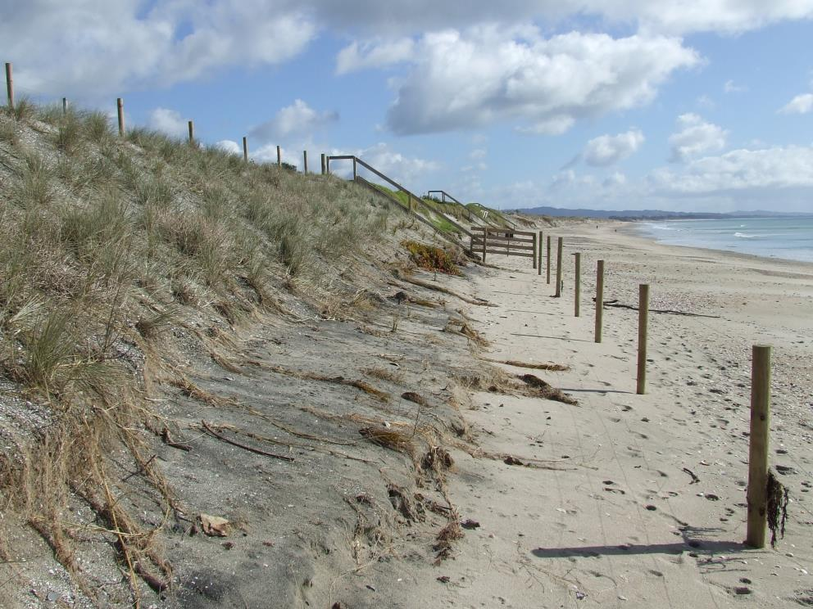
Storm erosion - 2007

Slide 17
Early dune restoration efforts
18 September 2006
Notes:
Dune planting day with Waipu Primary – August 2008
Some of this planting still in place. Main issue – too steep

Slide 18
Notes:
Planting 2010

Slide 19
2014 – second resource consent
18 September 2006

Slide 20
Notes:
Planning

Slide 21
Notes:
July 2014. Bank continuing to erode back with storms. Great timing as dune shaping scheduled to take place soon! Consent granted!

Slide 22
Notes:
Kikuyu and buffalo grass sprayed to keep off dune

Slide 23
Notes:
First stage – scrape off exotic grasses and place at back of reserve

Slide 25
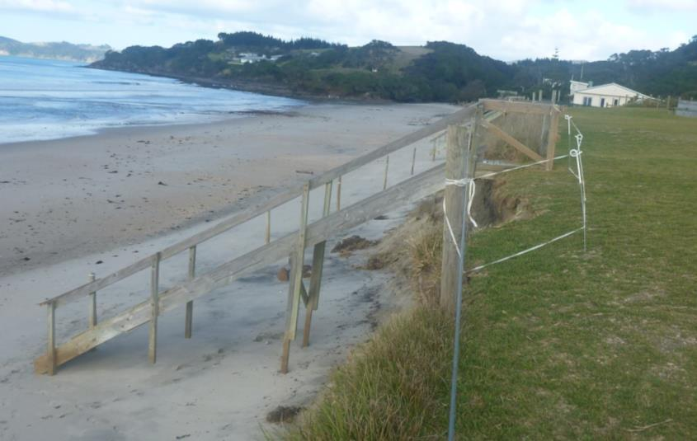
Notes:
Steps down to beach were removed and re-sited and replaced after the shaping. Bedded well into dune with top platform extending back into bank to reduce changes of being undermined again

Slide 27
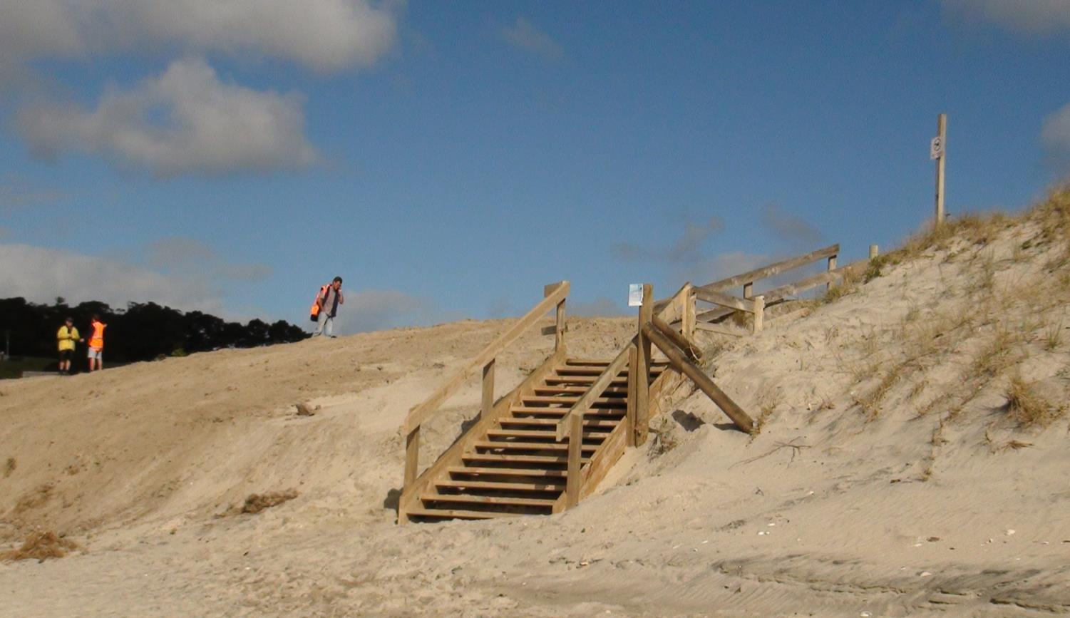
Notes:
Slope modelled on natural dune north

Slide 28
Notes:
Planting day one with Northtec

Slide 29
Notes:
Planting day two with Waipu primary

Slide 34
Notes:
2014-11-04 Grassed reserve maintained, in fact wider than previously!

Slide 35
Acknowledgements
Anton & Lucy Trist, Camp Waipu Cove (project management)
Andre & Robin La Bonte, La Bonte Coastal Consultants (resource consent application and planning)
David & Michael Bergin and Jim Dahm, Dunes Trust
Waipu Cove Primary School (planting volunteers)
Northtec (planting volunteers)
People Potential (planting volunteers)
Hansens Contracting (earthworks)
Worthy & Cox Builders (walk-ways)

Slide 36
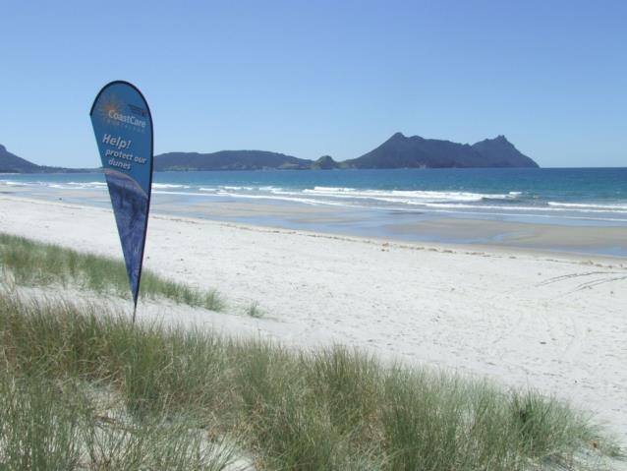
Laura Shaft
CoastCare Co-ordinator
09 4701138
lauras@nrc.govt.nz
www.nrc.govt.nz/coastcare

